Slide 1
MCA105-Operating System

Slide 2
Agenda
File implementation

Slide 3
In-memory file system structure
In-memory partition table-t contains information about each mounted volume.
In-memory directory structure-directory information of recently accessed directories.
System wide open-file table-It contains the copy of FCB of each open file.
Per-process open-file table-It contains information opened by that particular process and it maps with appropriate system wide open-file.

Slide 4
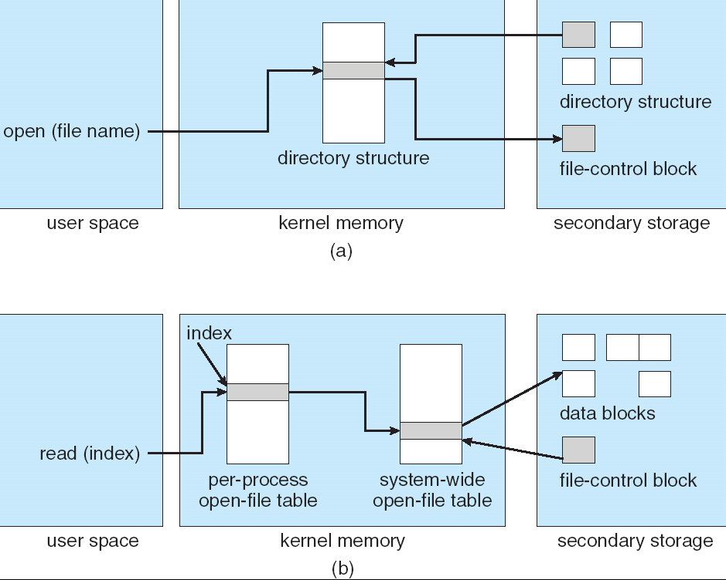
In-Memory File System Structures

Slide 6
Directory Implementation
Linear list of file names with pointer to the data blocks.
simple to program
time-consuming to execute
Hash Table – linear list with hash data structure.
decreases directory search time
collisions – situations where two file names hash to the same location
fixed size

Slide 8
Allocation Methods
An allocation method refers to how disk blocks are allocated for files:
Contiguous allocation
Linked allocation
Indexed allocation

Slide 9
Contiguous Allocation
Each file occupies a set of contiguous blocks on the disk
Simple – only starting location (block #) and length (number of blocks) are required
Random access
Wasteful of space (dynamic storage-allocation problem)
Files cannot grow

Slide 10
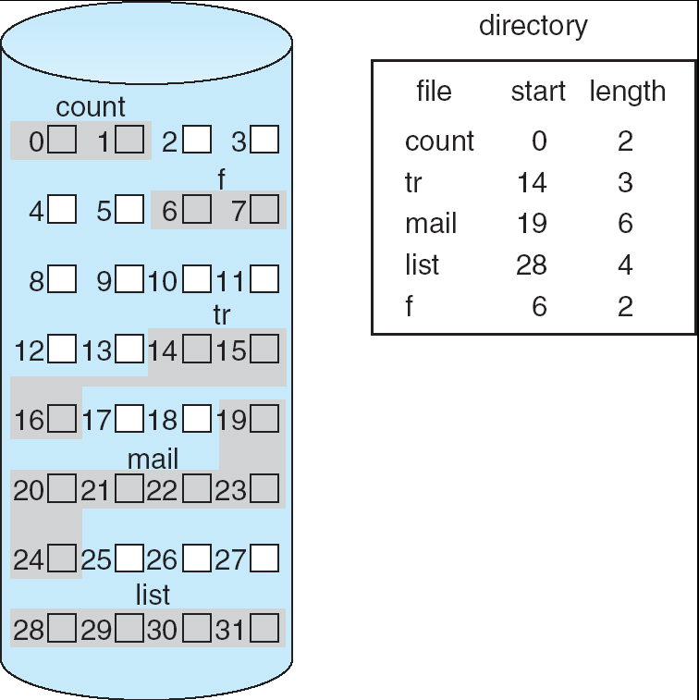
Contiguous Allocation of Disk Space

Slide 11
Extent-Based Systems
Many newer file systems use a modified contiguous allocation scheme
Extent-based file systems allocate disk blocks in extents
An extent is a contiguous block of disks
Extents are allocated for file allocation
A file consists of one or more extents.

Slide 12
Linked Allocation
Each file is a linked list of disk blocks: blocks may be scattered anywhere on the disk.
block =
pointer

Slide 13
Linked Allocation (Cont.)
Simple – need only starting address
Free-space management system – no waste of space
No random access
Mapping
File-allocation table (FAT) – disk-space allocation used by MS-DOS and OS/2.

Slide 14
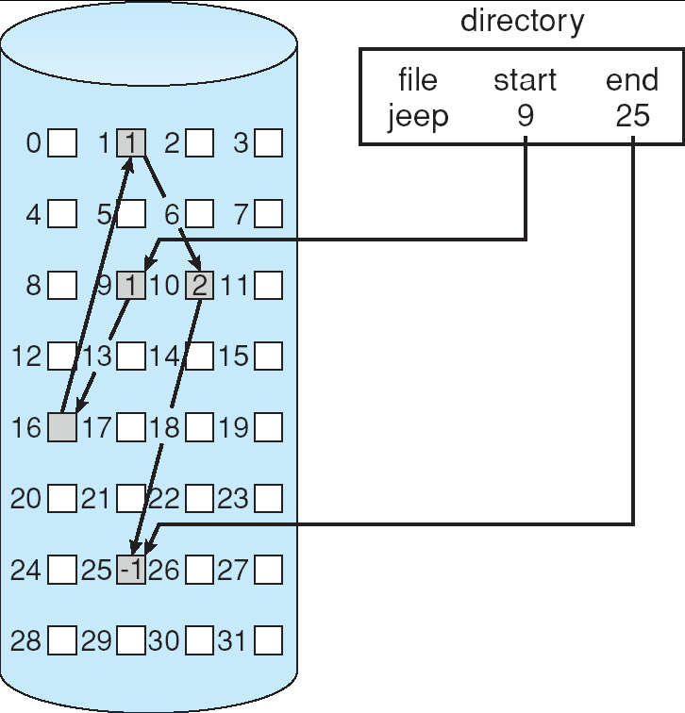
Linked Allocation

Slide 15
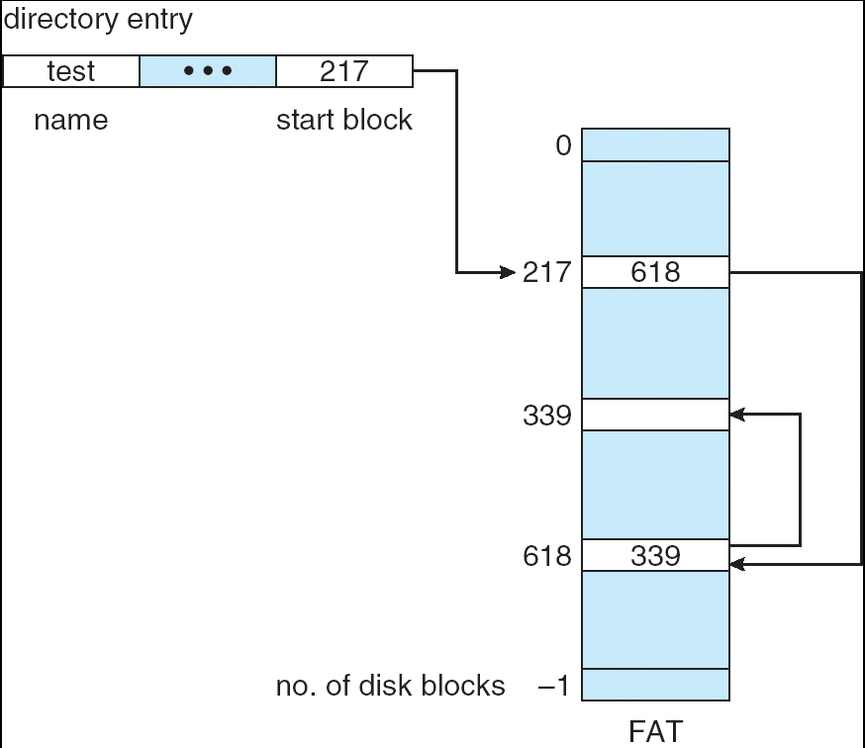
File-Allocation Table

Slide 16
Indexed Allocation
Brings all pointers together into the index block.
Logical view.
index table

Slide 17
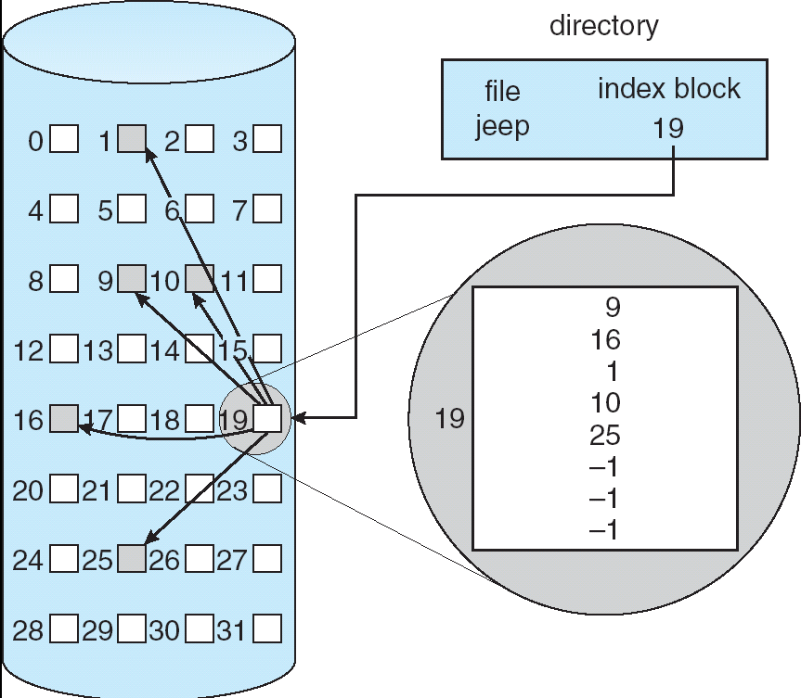
Example of Indexed Allocation

Slide 18
Indexed Allocation (Cont.)
Need index table
Random access
Dynamic access without external fragmentation, but have overhead of index block.

Slide 19
Indexed Allocation – Mapping (Cont.)

outer-index
index table
file

Slide 20
Free-Space Management
File system maintains free-space list to track available blocks/clusters
(Using term “block” for simplicity)
Bit vector or bit map (n blocks)
0
1
2
n-1
…
1 ⇒ block[i] free
0 ⇒ block[i] occupied
bit[i] =

Block number calculation
(number of bits per word) *
(number of 0-value words) +
offset of first 1 bit
CPUs have instructions to return offset within word of first “1” bit

Slide 21
Free-Space Management (Cont.)
Bit map requires extra space
Example:
block size = 4KB = 2¹² bytes
disk size = 2⁴⁰ bytes (1 terabyte)
n = 2⁴⁰/2¹² = 2²⁸ bits (or 32MB)
if clusters of 4 blocks -> 8MB of memory
Easy to get contiguous files

Slide 22
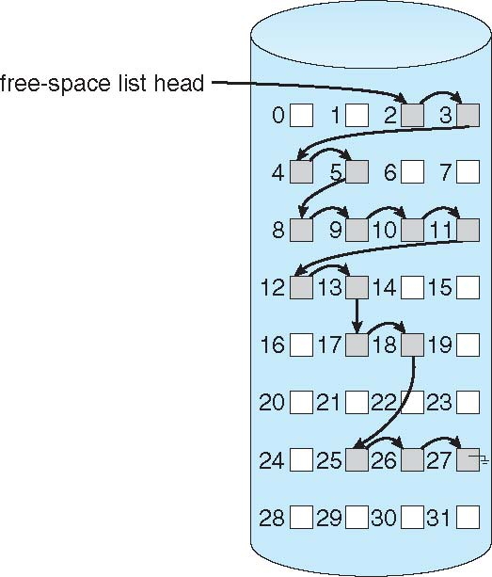
Linked Free Space List on Disk
Linked list (free list)
Cannot get contiguous space easily
No waste of space
No need to traverse the entire list (if # free blocks recorded)

Slide 23
Free-Space Management (Cont.)
Grouping
Modify linked list to store address of next n-1 free blocks in first free block
Counting
Because space is frequently contiguously used and freed, with contiguous-allocation, extents, or clustering
Keep address of first free block and count of following free blocks
Free space list then has entries containing addresses and counts

Slide 24
THANK YOU

